Slide 1


Adventure works
ExcelR Data Analyst Project
Group 4

Slide 2
Group 4
Dishant Chogle
K.Eswar Praneeth
Jagan Kumar Sahoo
Sai Harsha
Sonali Virkar
Swati Kannure

Slide 3
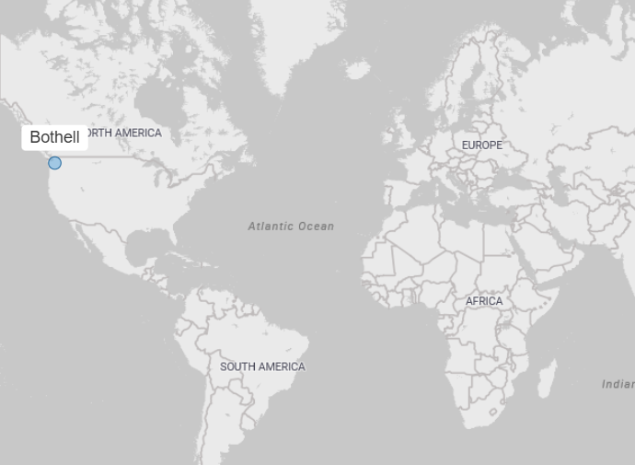
Overview
Adventure Works Cycles, is a large, multinational manufacturing company. The company manufactures and sells metal and composite bicycles to North American, European and Asian commercial markets. While its base operation is in Bothell, Washington with 290 employees, several regional sales teams are located throughout their market base.
In 200s, Adventure Works Cycles bought a small manufacturing plant in Mexico. Which manufactures several critical subcomponents for the Adventure Works Cycles product line. These subcomponents are shipped to the Bothell location for final product assembly. In 2001, this manufacturing plant became the sole manufacturer and distributor of the touring bicycle product group.
Coming off a successful fiscal year, Adventure Works Cycles is looking to broaden its market share by targeting their sales to their best customers, extending their product availability through an external Web site, and reducing their cost of sales through lower production costs.

Slide 4
Objective of the project
Analyze the Adventure Works dataset to derive actionable business insights.
Identify the company's most profitable products.
Determine the highest-selling products of the business.
Segment sales performance to pinpoint regions with higher and lower sales.
Investigate and explain the factors driving increases and decreases in sales.
Evaluate the profit margin across the business.
Determine the overall Production Cost for the business's operations.
Provide an overall analysis of the business's data, covering key metrics like customer base, sales and profit.

Slide 5
Data Cleaning & Modelling
Data was cleaned using the Power Query Editor for both Excel and Power BI.
During cleaning, null values exceeding 50% were removed from the data.
Blank rows were also removed from the dataset.
Two tables of sales were combined using the Append Queries option in Power Query.
The Product, Product Category, and Subcategory files were merged.
A Data Model was created, designating the Sales table as the fact table.
Date columns were formatted into the proper date types for data analysis.

Slide 6
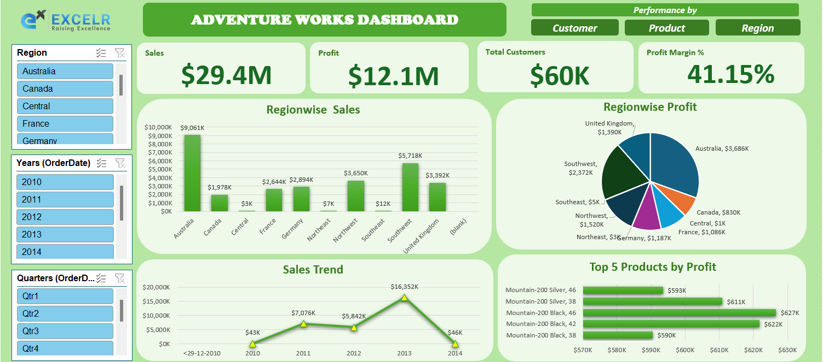
Excel Dashboard

Slide 7
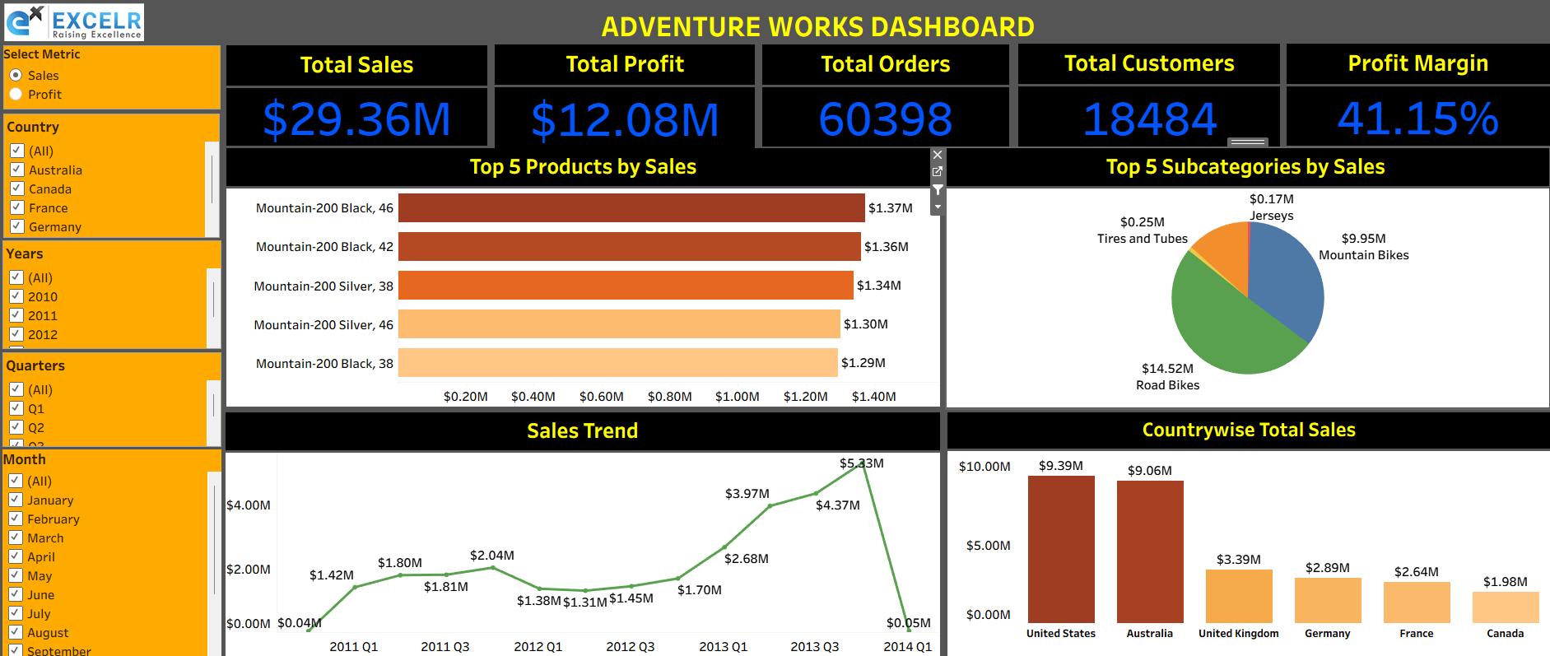
Tableau Dashboard

Slide 8
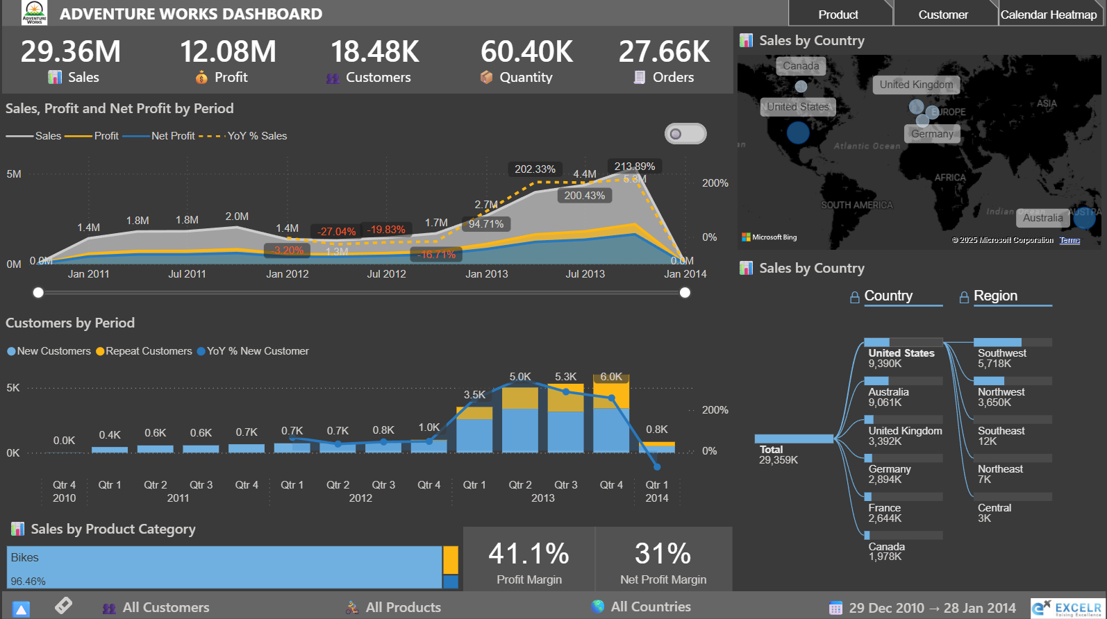
Power Bi Dashboard

Slide 9
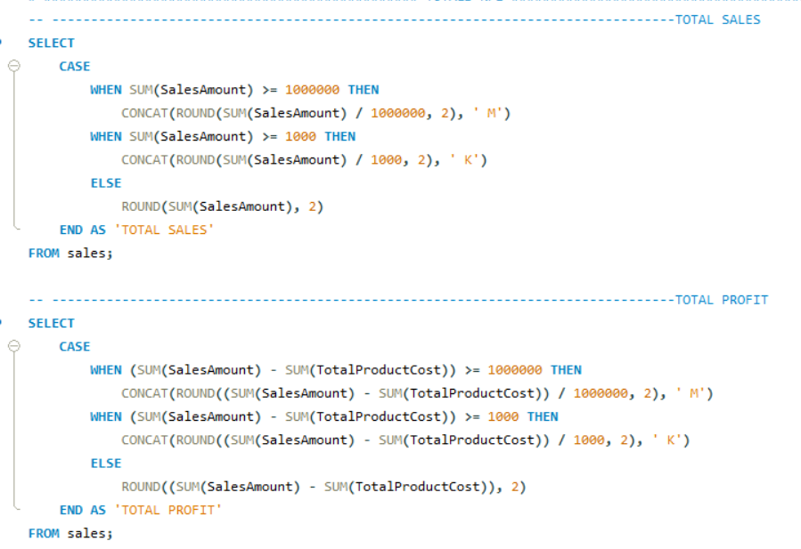
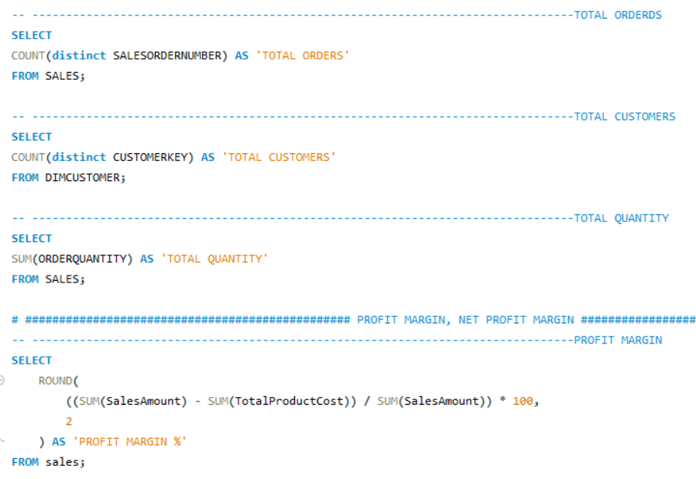
SQL QUERIES

Slide 10
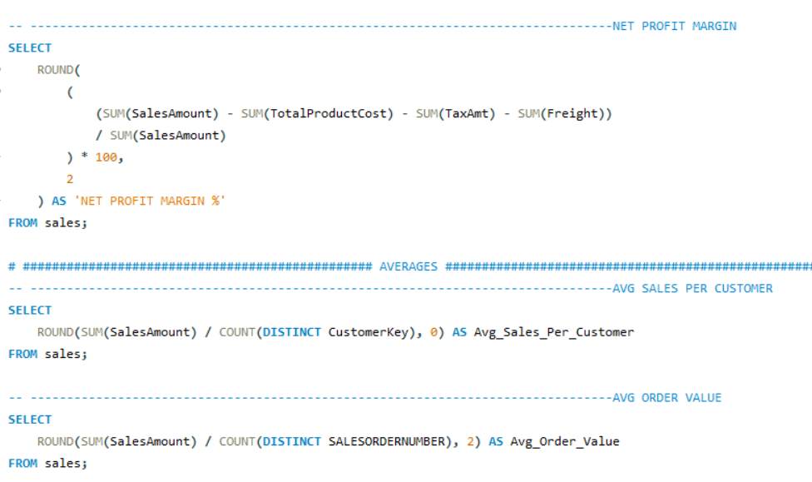
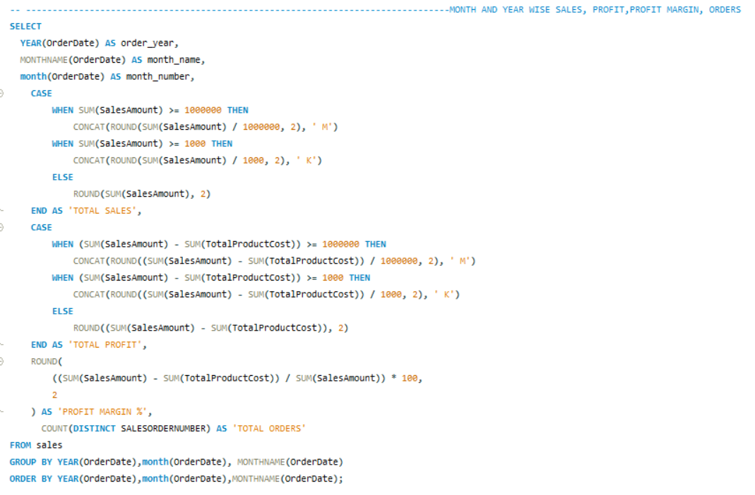

Slide 11
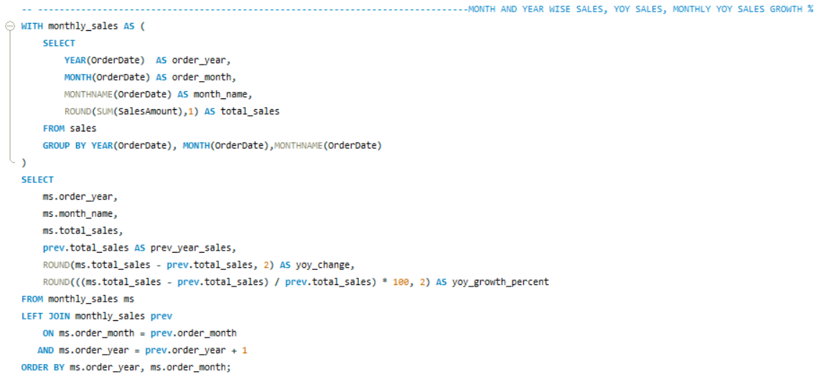
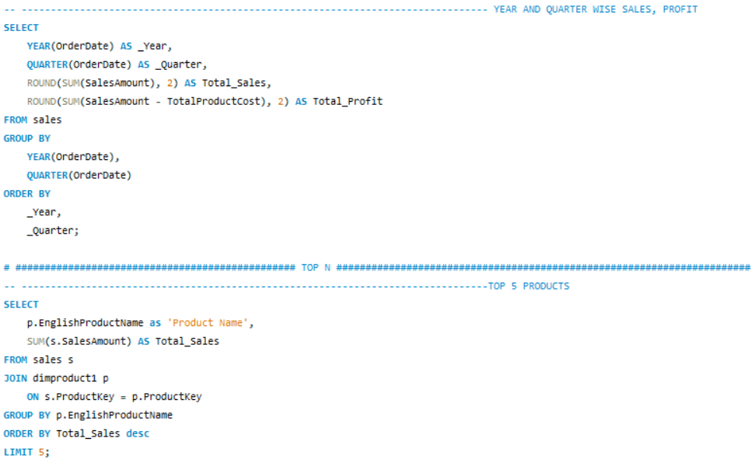

Slide 12
Summary
Stable gap between gross and net profit margins indicates strong operational efficiency.
Moderate pricing shift in 2012 (from high-end to mid-tier bikes) and reduced production cost improved affordability and market reach.
Accessories and apparel generate high unit volume and excellent cross-sell potential
Bundling strategies — pairing bikes with related gear (stands, helmets, tires) — can increase transaction value and profit per sale.
Mountain Bikes deliver higher margins, suggesting focus on premium, high-margin inventory.
Higher repeat purchases from existing customers, reflecting strong retention.
Q4 consistently shows a seasonal sales spike, likely tied to global festive periods and holiday promotions boosting demand.
Diversification — launch of two new product categories at the end of 2012 expanded customer base.
Regional contrast in target audiences of North America & Europe. Strategic Opportunity: Similar consumer profiles to Europe can be surveyed in urban East and Central U.S. markets (e.g., New York, Chicago, Boston). Targeting these city-based, price-sensitive commuters could boost market expansion and brand penetration in North America.
Low growth in new bike customers in first 3 quarters of 2013 suggests need for deeper market surveys and customer demand analysis to guide future product and pricing strategies.

Slide 13
Conclusions
Adventure Works continues to build momentum through diversification, operational excellence, and customer loyalty. Future growth should focus on:
Leveraging festive-season peaks (Q4) for global sales drives.
Expanding high-margin Mountain Bikes production while maintaining varied range of Road Bikes.
Capitalizing on accessory bundling opportunities and diversification of revenue base.
Targeting Europe-like urban commuter audiences in major eastern U.S. cities to strengthen its North American footprint.

Slide 14
THANK YOU

